Slide 1

MancsTárs
Szili Bettina
Rákóczi Viktória
Petrás Kata Magdolna

Slide 2
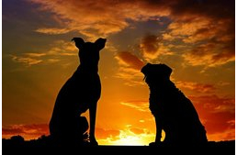
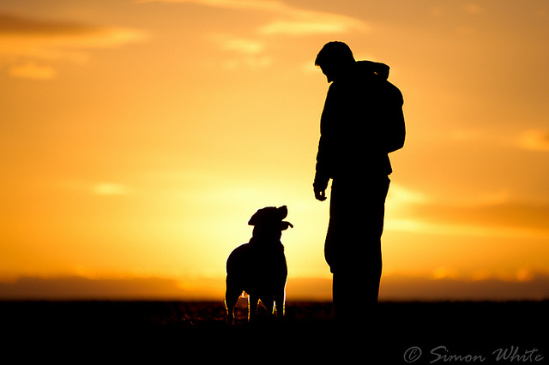
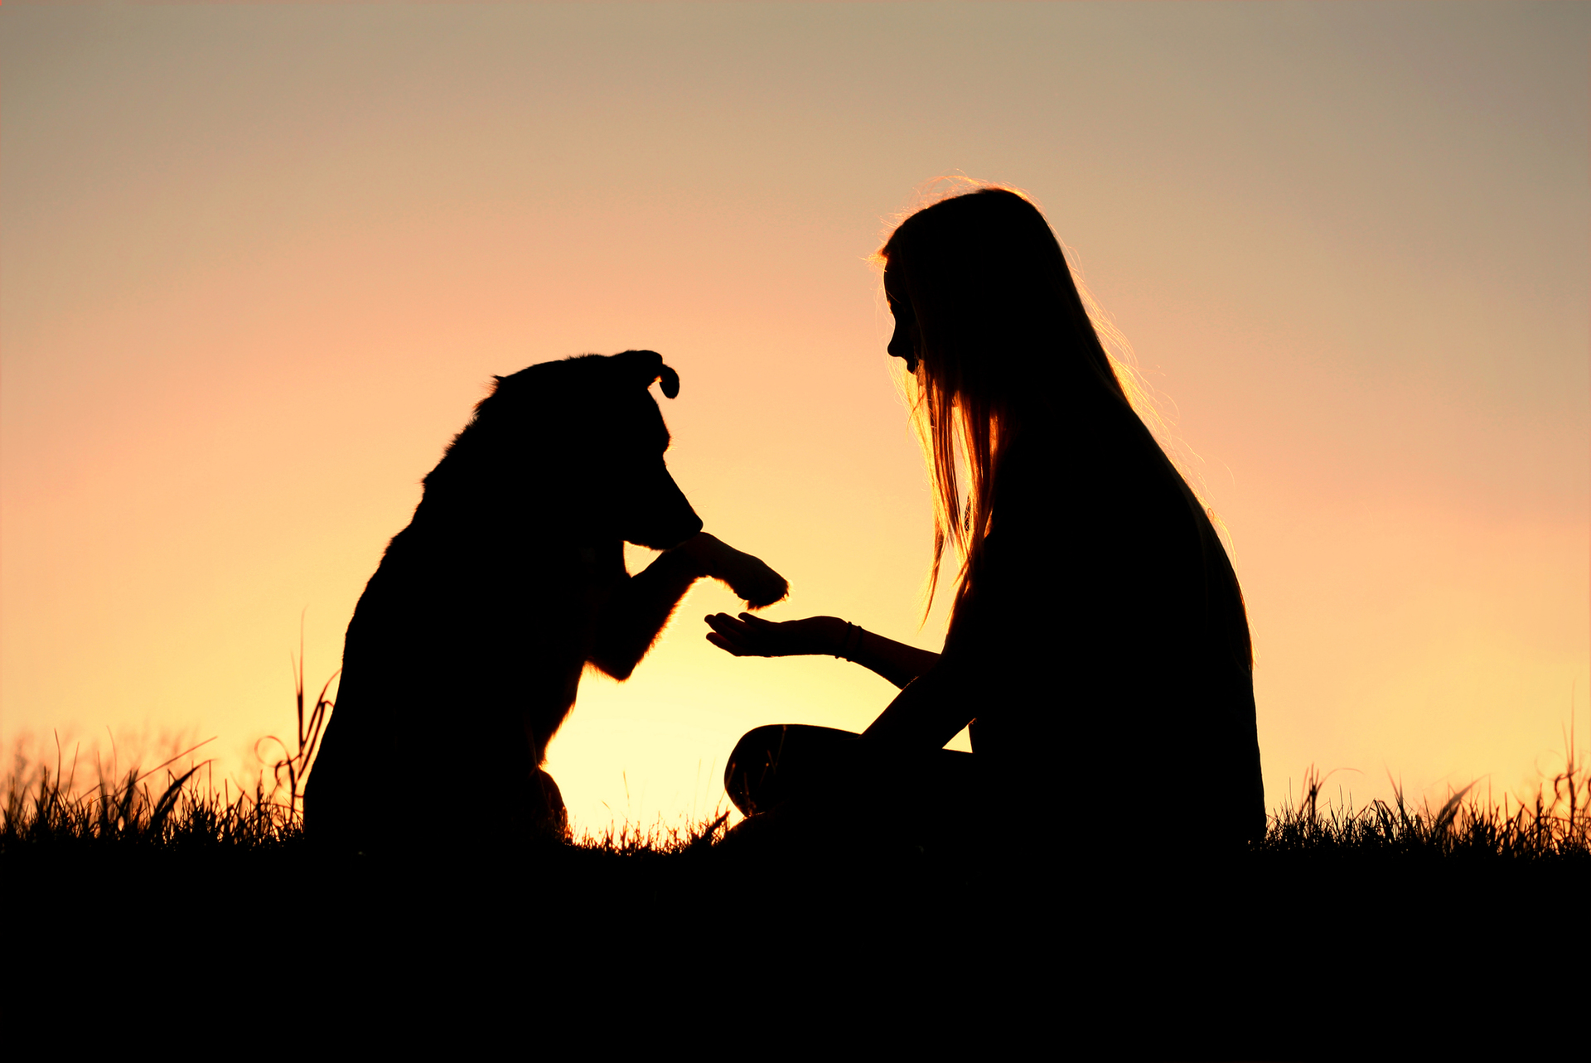
-MancsTárs simplifies the adoption process
-provides shelters with a wider reach, increasing the chances of adoption

Slide 3









Our project aim to solve the following problems:
Animal shelters struggle to reach a wider audience.
Hard to find nearby shelters.
The adoption process for shelter animals is often difficult and inefficient
People and animals may have mismatched needs, leading to unsuccesful adoptions

Slide 4
Work distribution:
01
02
03
Szili Bettina
Rákóczi Viktória
Petrás Kata
Frontend, webdesign, project manager
Backend, Testing
Content, Database

Slide 5
Technologies used:
Backend: NetBeans, Java, Postman,WildFly
Database: MySQL, MAMP,phpMyAdmin
Frontend: Visual Studio Code, Angular, Bootstrap, CSS, TypeScript, HTML
Design: Figma
Ddiagram: DBdDiagram.io

Slide 6


Project managment and Teamwork:
For sharing our work: GitHub
For tracking our work progress: Jira

Slide 7
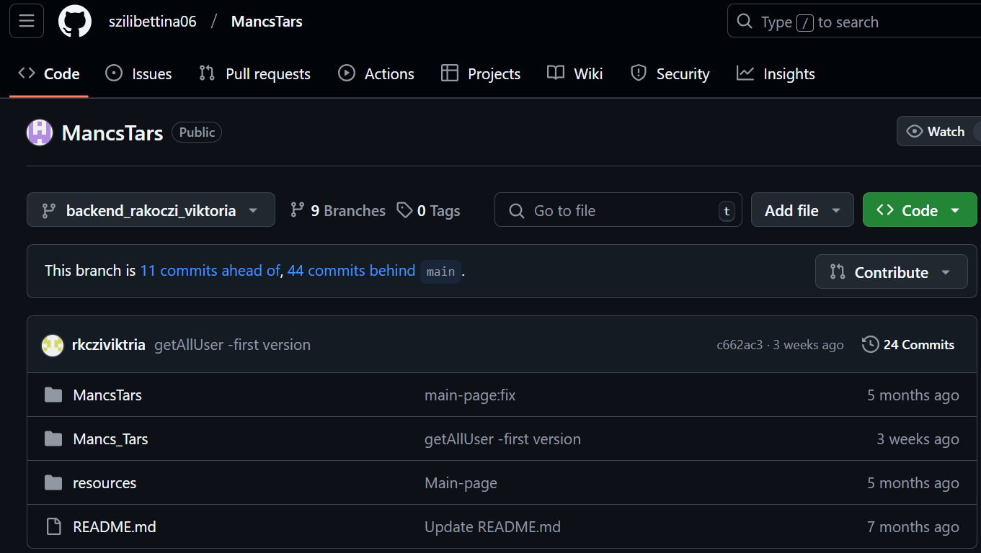
Github:
Backend branch

Slide 8
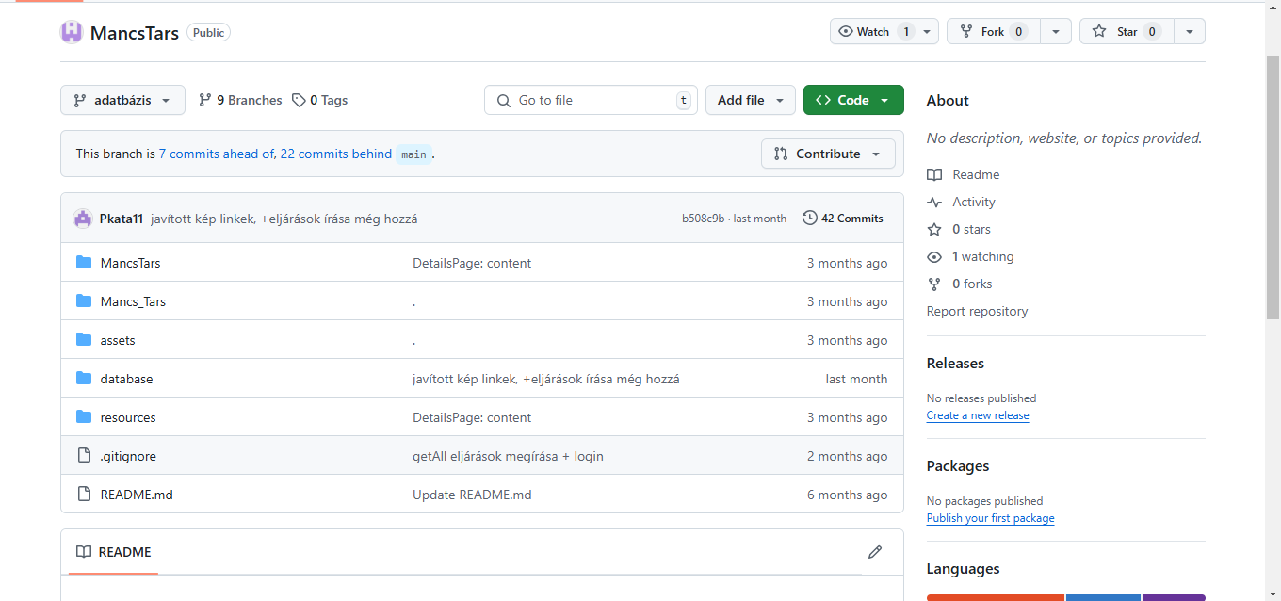
Github:
Database branch

Slide 9
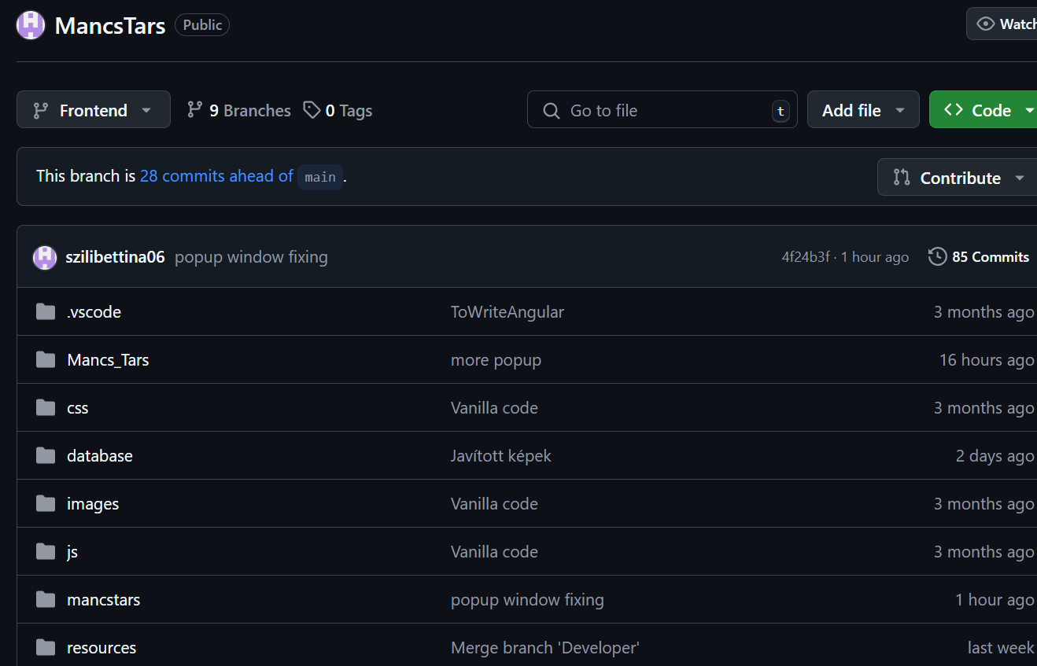
Github:
Frontend branch

Slide 10
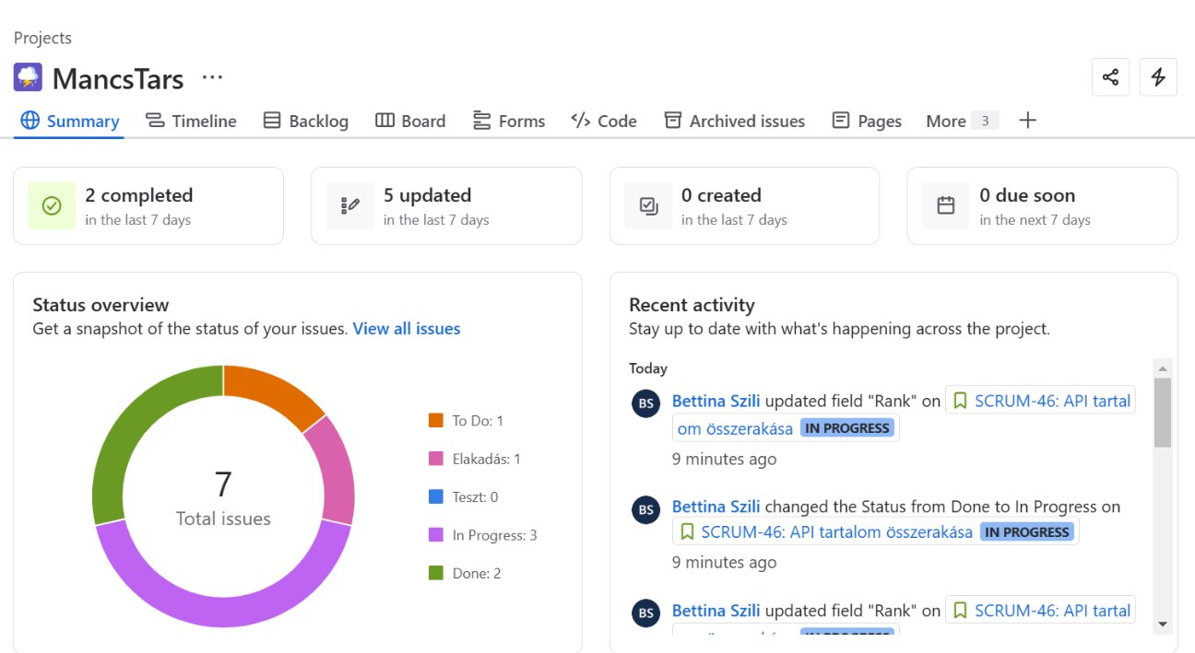
Jira:
For workflow management, we used Jira, which allowed us to divide tasks, track our working hours, and monitor project progress.

Slide 11
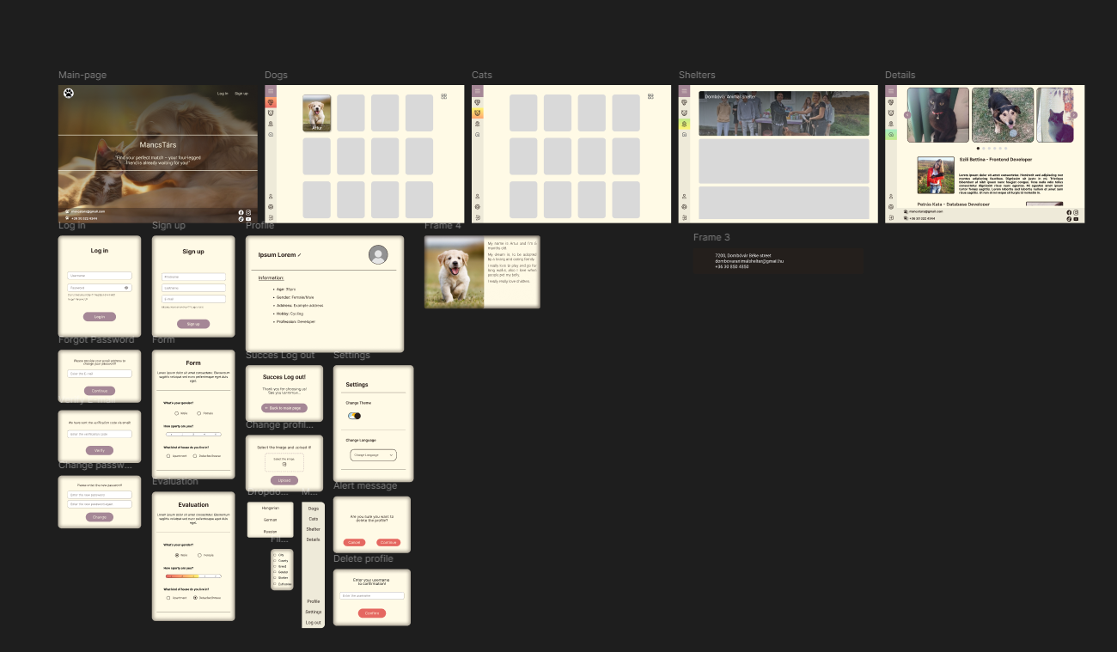
Webdesign
-Theme: warmness calmness and reliability
-User friendly
-Balance of uniqueness and modern webdesign

Slide 12
User functions:
Users can "like" a pet, adding it to their profile
They can filter animals by their traits
Users can upload profile pictures and personal details

Slide 13
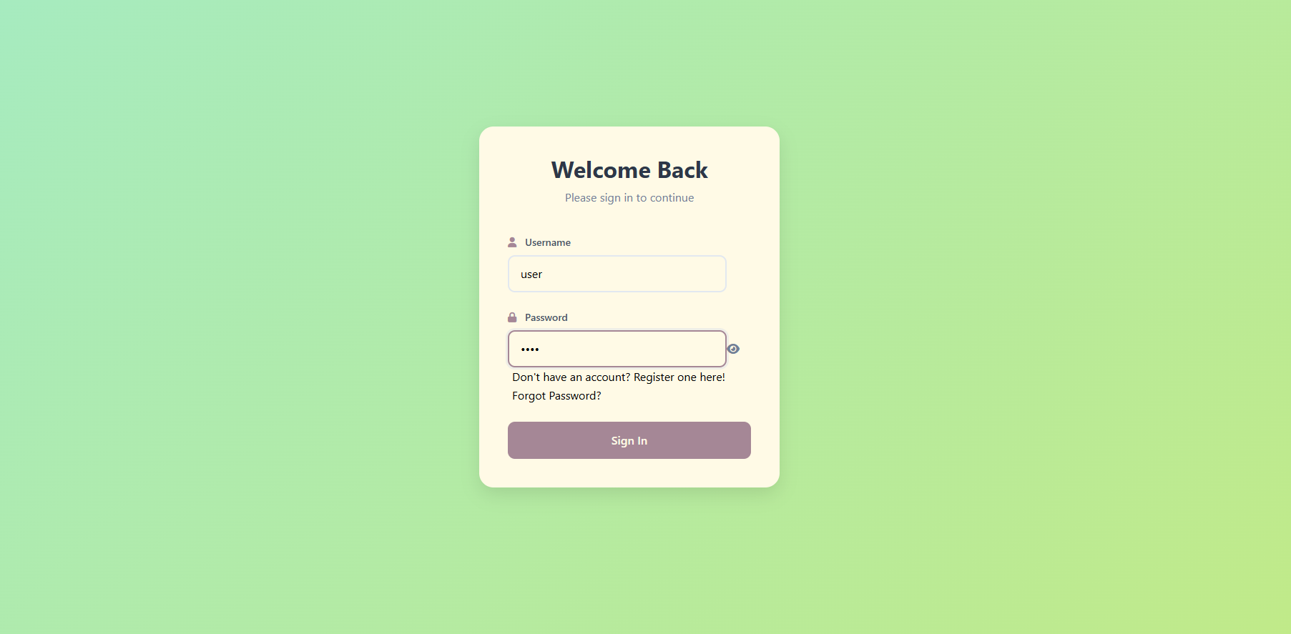
User interface:

Slide 14
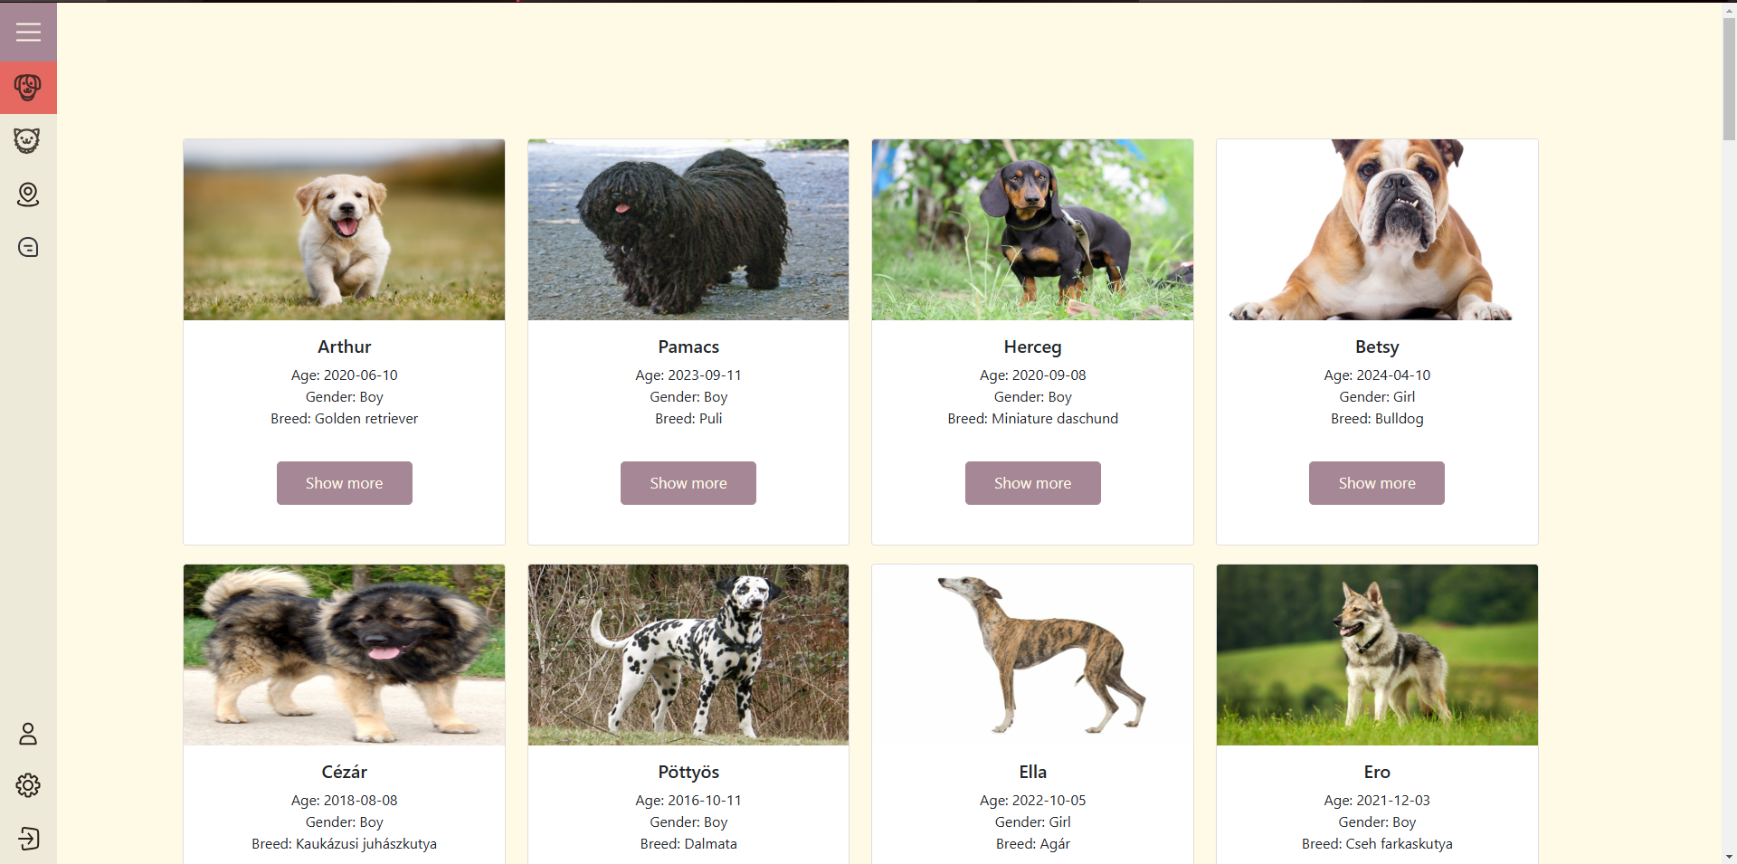
User interface:

Slide 15
Admin functions:
Can add, update or delete an animal

Slide 16
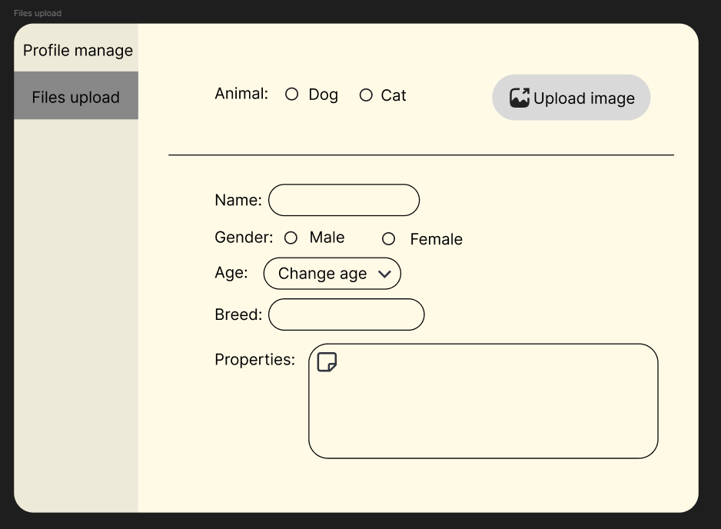
Admin panel:

Slide 17
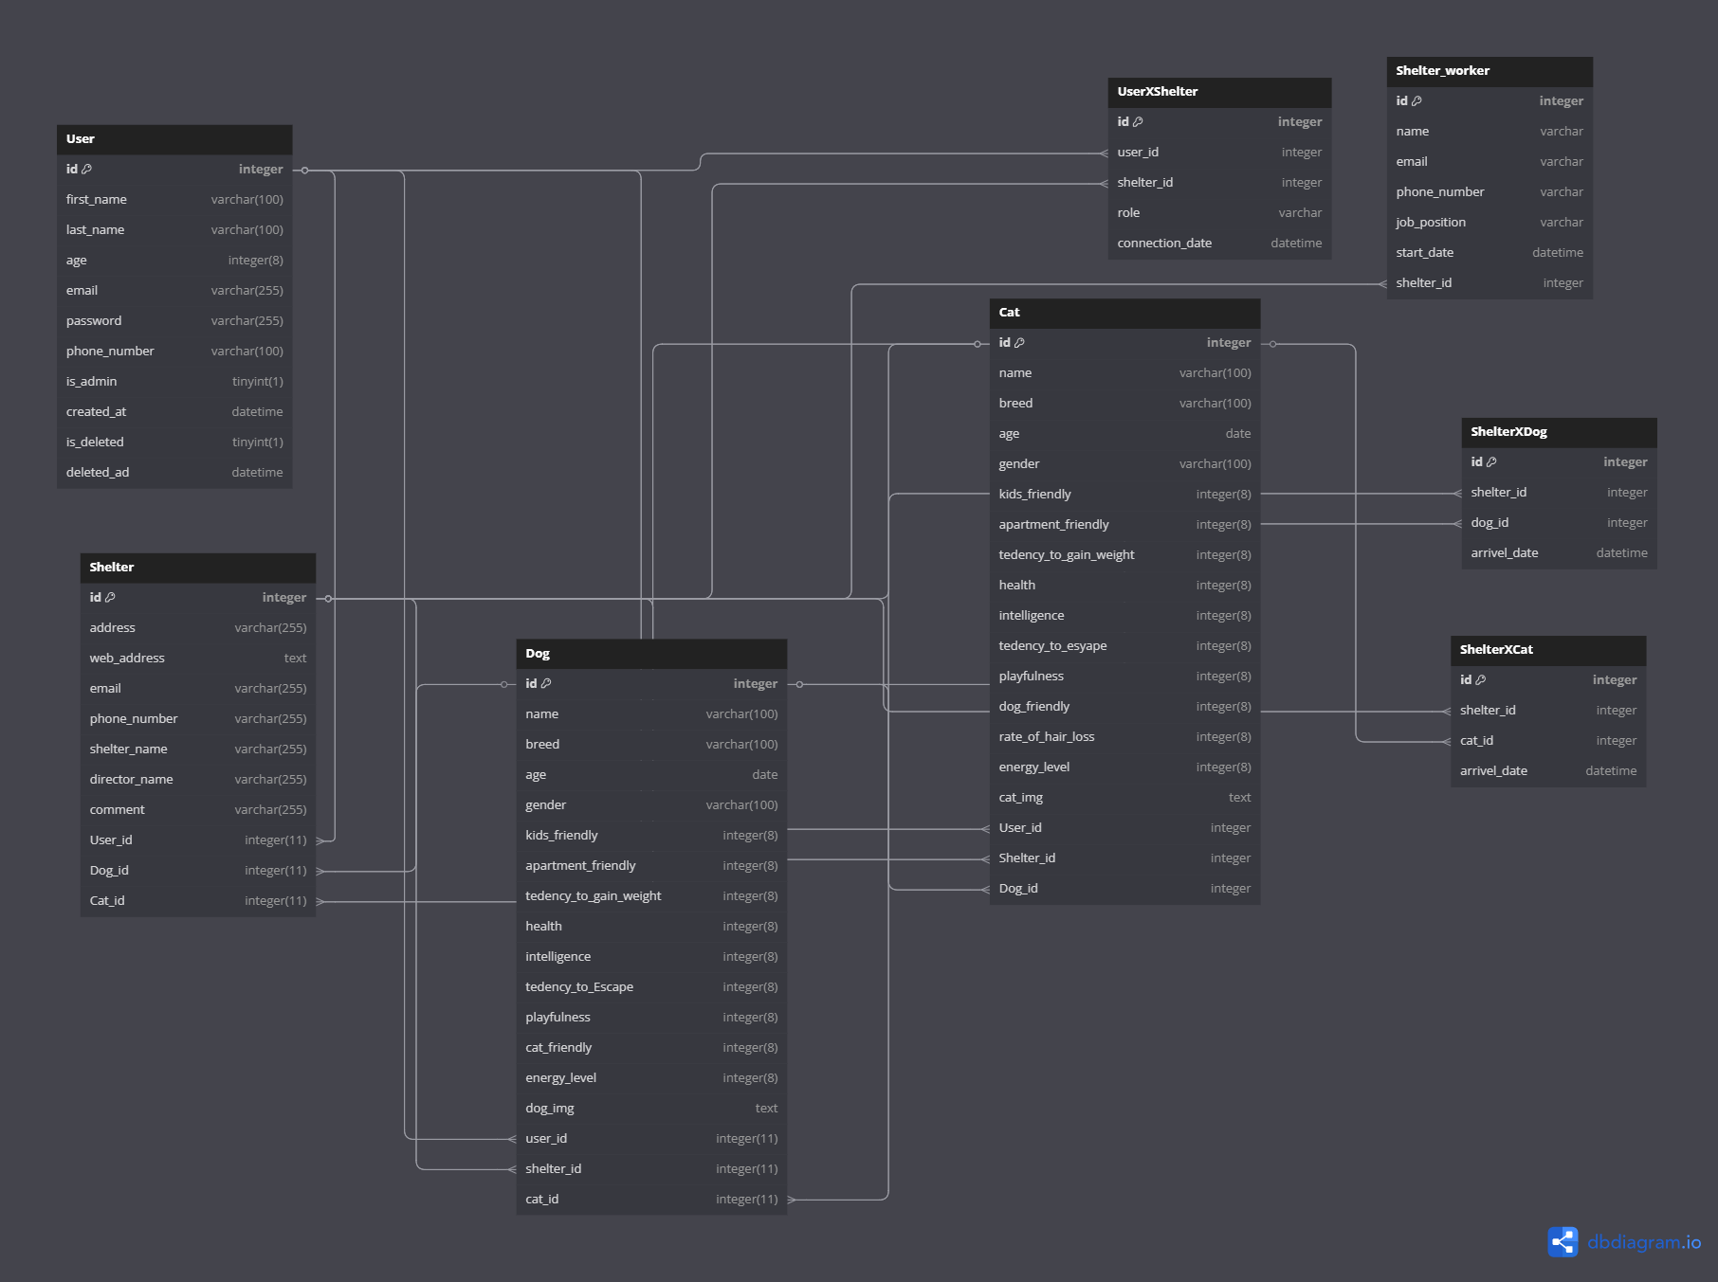

DBDIAGRAM:
Relationships:
Users and Animals: many to many
Shelters and Animals: one-to-many
Users and Shelters: many-to-many
.

Slide 18
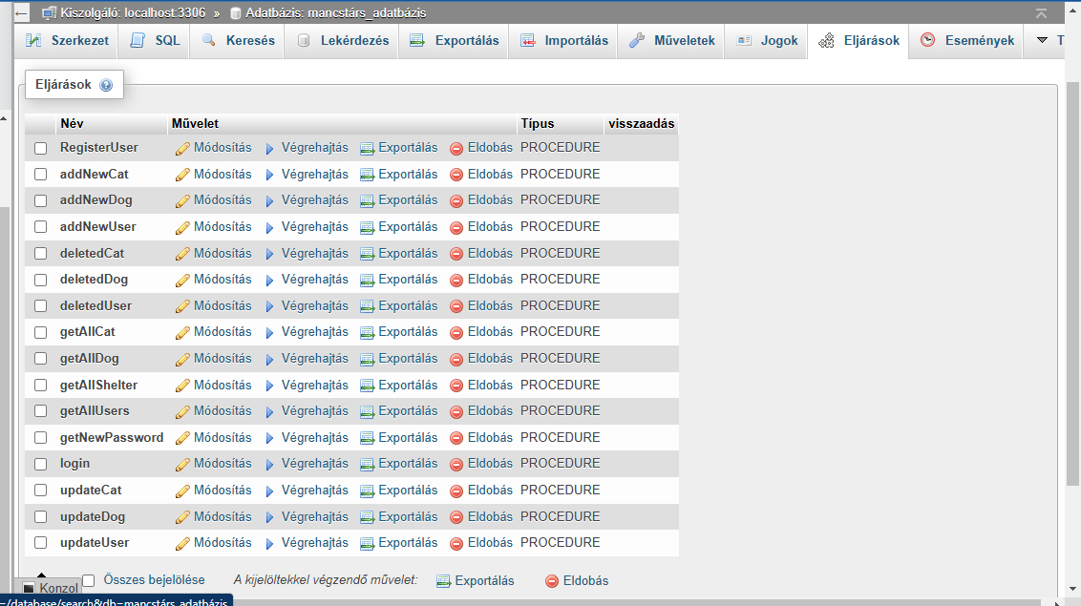
Database:
Retrieving all animals
Updating and deleting
User registration and login(with password hashing)

Slide 19
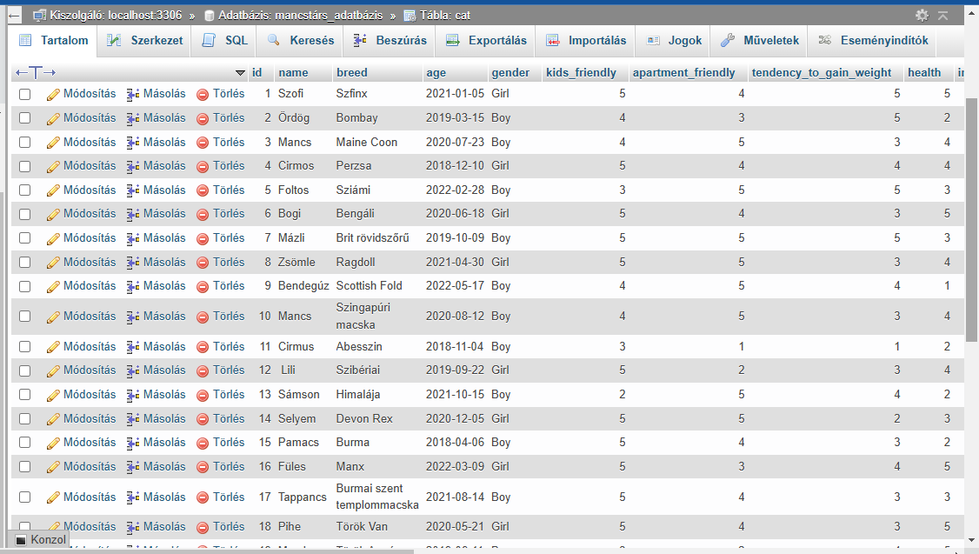
Database:

Slide 20
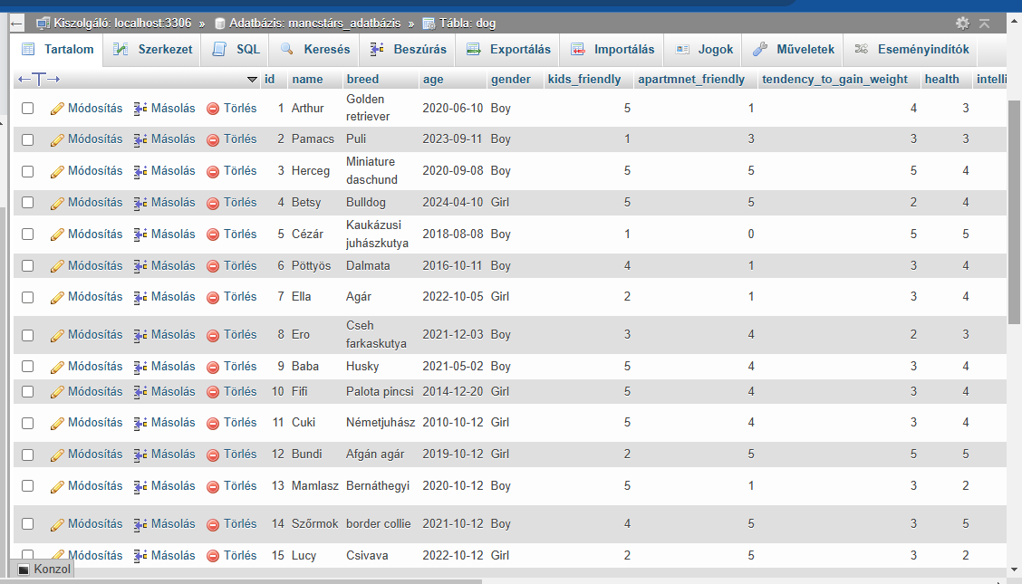
Database:

Slide 21
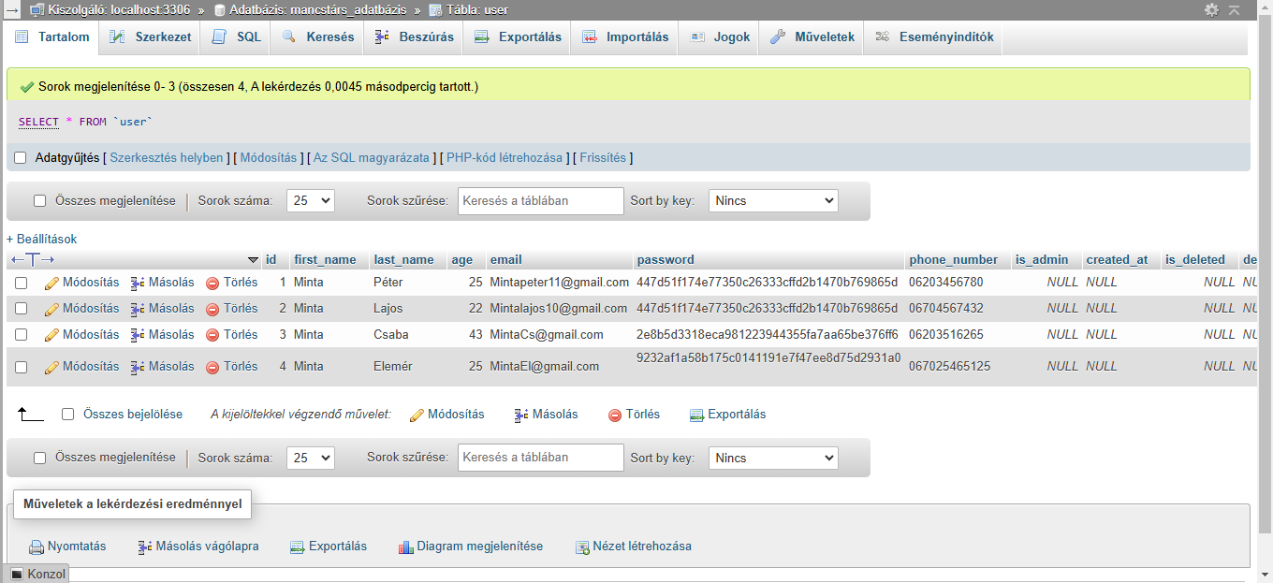
Database:

Slide 22
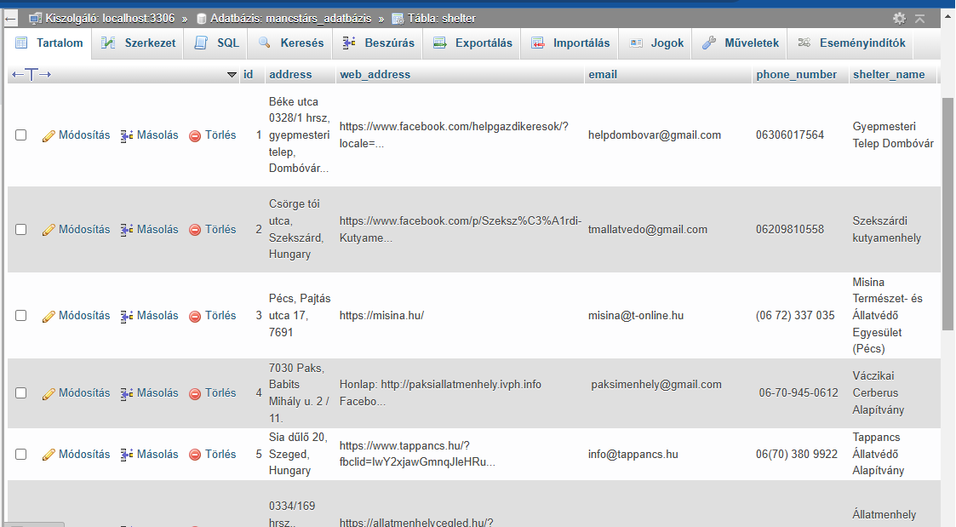
Database:

Slide 23
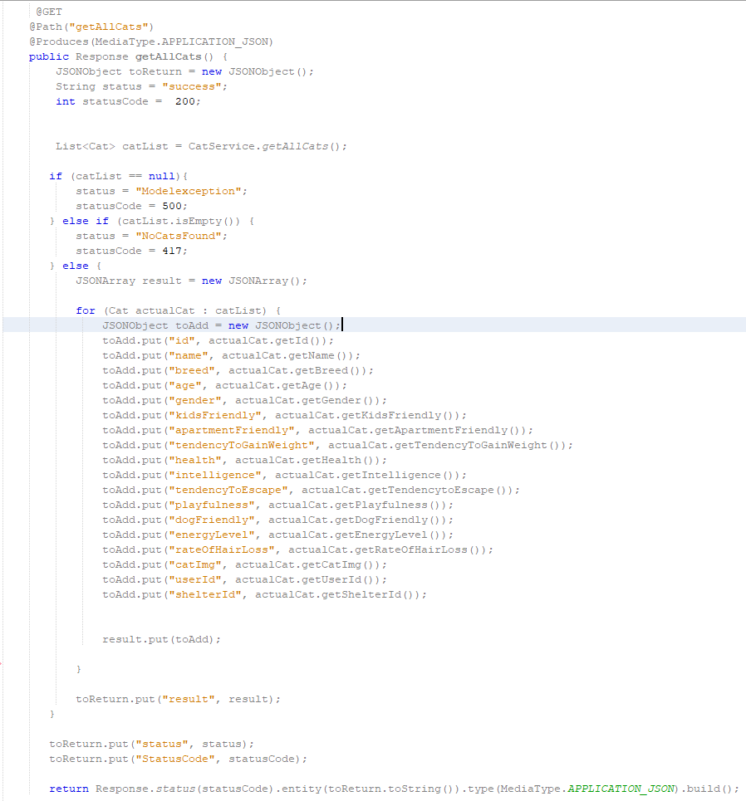
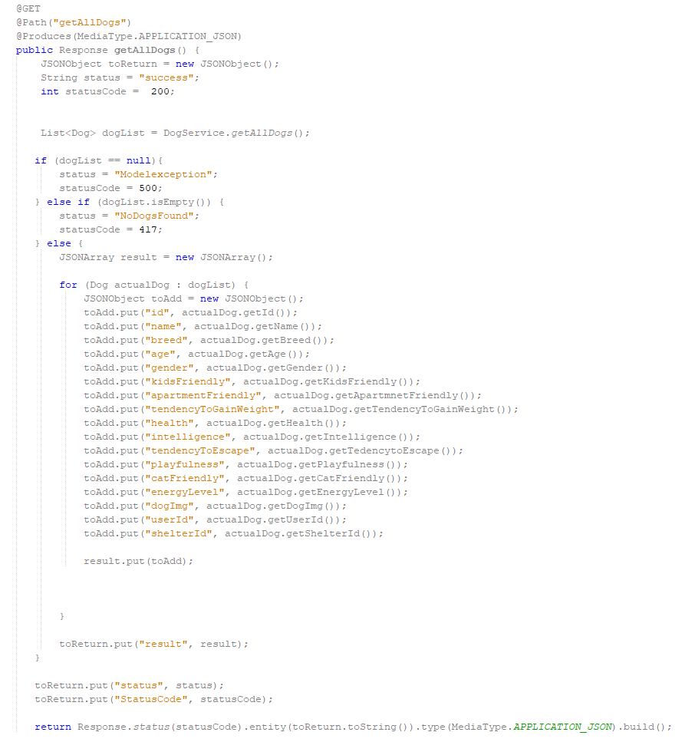
Rest Api-s:

Slide 24
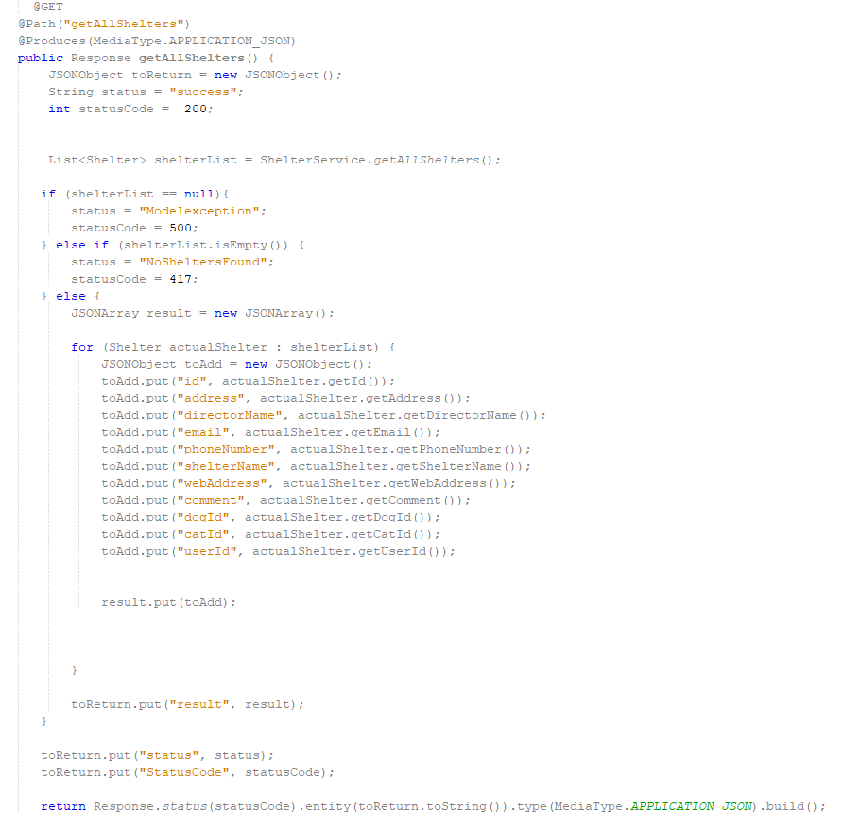

Slide 25
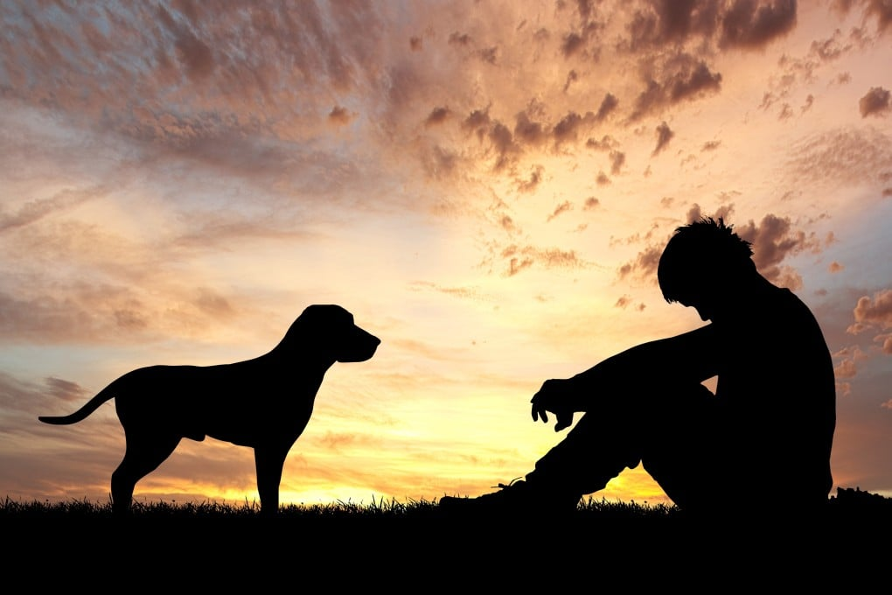
Future plans:
Develop an algorithm that, based on a completed test, will match users with the most suitable animal for them
Users can send message directly to shelters, from our site

Slide 26
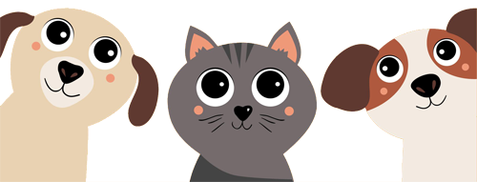
Thank you for your attention, feel free to ask questions!
.

